Slide 1
Civic Tech and LoRaWAN Hackathon for a better city

Slide 2
welcome!
again! ;)

Slide 3


What is this?
We are bringing together the local maker community and the city administration to explore new ways of solving problems of our city with the help of open networks and civic tech.
Maker days | Hackdays | Hackathon

Slide 4
What is this?
Collaboration
Openness
Creativity
Notes:
Collaborate with others, to share knowledge and ideas
Be open in all aspects, and promote openness of your work (open source, open data, etc)
Create freely, don’t think inside the (challenge) box, that is just one suggestion, feel free to explore.
And last, but not least… (next slide) be excellent to each other.

Slide 5

Be excellent to each other!
Code of Conduct

Slide 6
Schedule (Today)
10:30 Welcome session
12:00 Lunch
18:00 Dinner
18:30 MakeZurich IoT Platform (Hivemind, V. Bhatnagar)
19:00 Visualizing Linked Data with d3.js (M. Mazenauer)
23:00 Realtime code art (Demoshow by O. Lavrovsky)

Slide 7
Schedule (Tomorrow)
09:00 Breakfast
12:00 Pizza
15:30 Final submission time
16:00 Presentations
18:00 Apéro
</MakeZurich>

Slide 8
Challenges
Seven
For a smarter city

Slide 9

Real time Occupancy rate
1
CHALLENGE
Discover ways to use technology to measure and understand occupancy rate of the public transport vehicles in real time.
Provided by VBZ
Peggy Neubert
Head of Service Quality, VBZ
Mail: peggy.neubert@vbz.ch
Phone: 044 411 4632

Slide 10
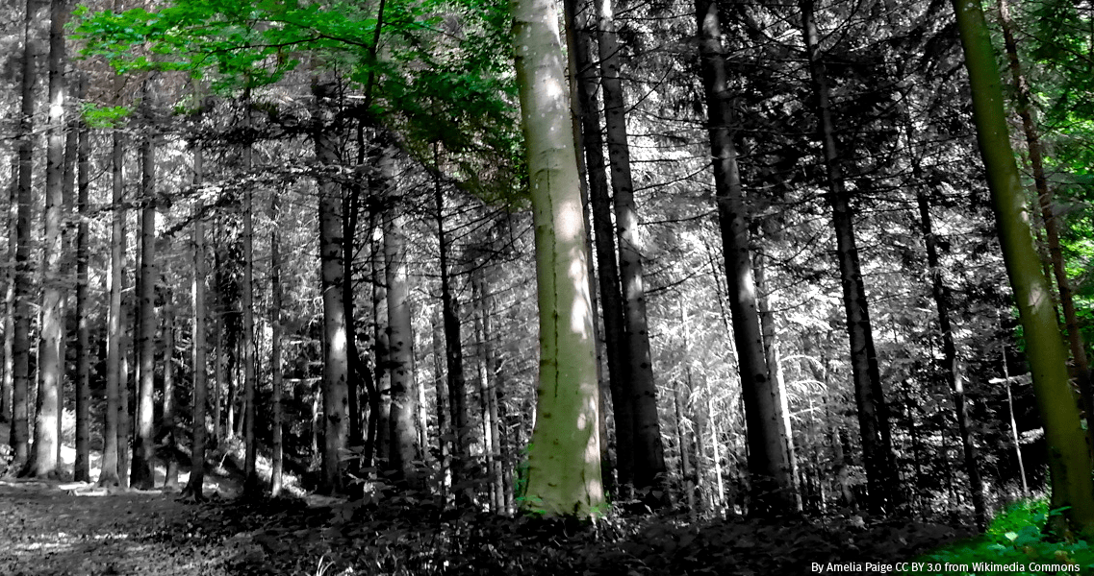
City Forest Visitors
2
Challenge
All year round, the forests of the city of Zurich receive thousands of visitors. How can we assess and quantify them easily and efficiently?
Provided by Grün Stadt Zürich
Regina Wollenmann / Marvin Bürgin
Forest management
Grün Stadt Zürich
marvin.buergin@zuerich.ch

Slide 11
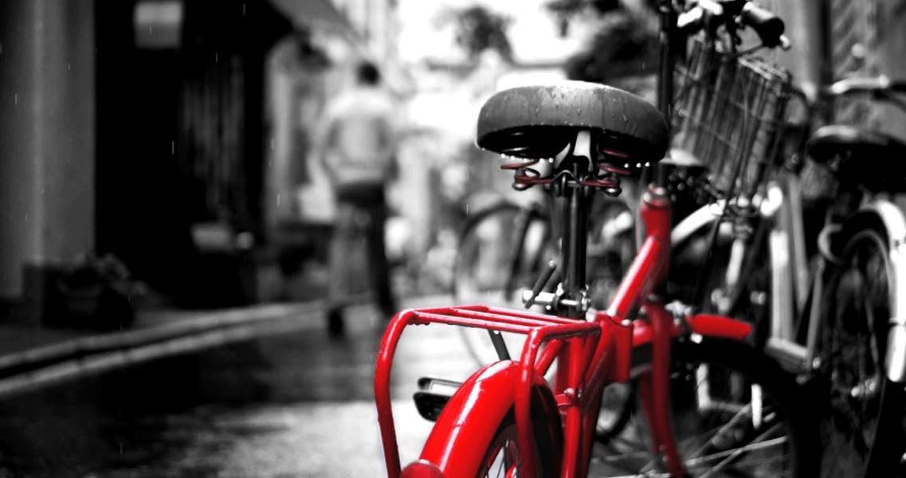
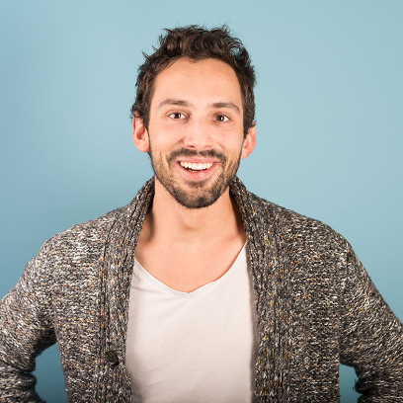
No Bike Left Behind
3
CHALLENGE
How can we track and recover abandoned bikes from the stationary sharing system of Züri Velo?
Provided by PubliBike
Thomas Hug
Location manager
PubliBike
thomas.hug@publibike.ch

Slide 12
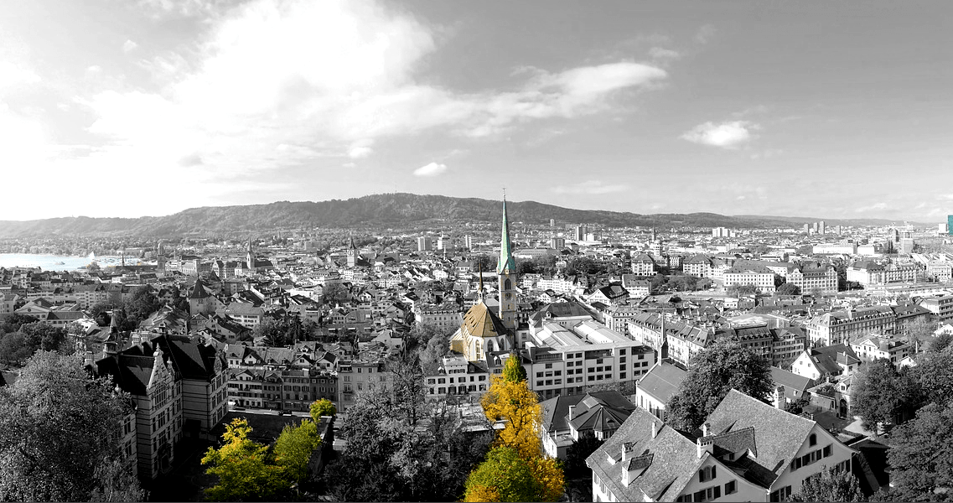
CONQUERING THE LAST MILE
4
4
CHALLENGE
Optimizing last-mile logistics is fundamental topic for a smarter city. How can we measure and visualize deliveries within the boundaries of the city?
Provided by the office for urban development
Simon Keller
Project manager
Office for urban development
simon.keller@zuerich.ch

Slide 13
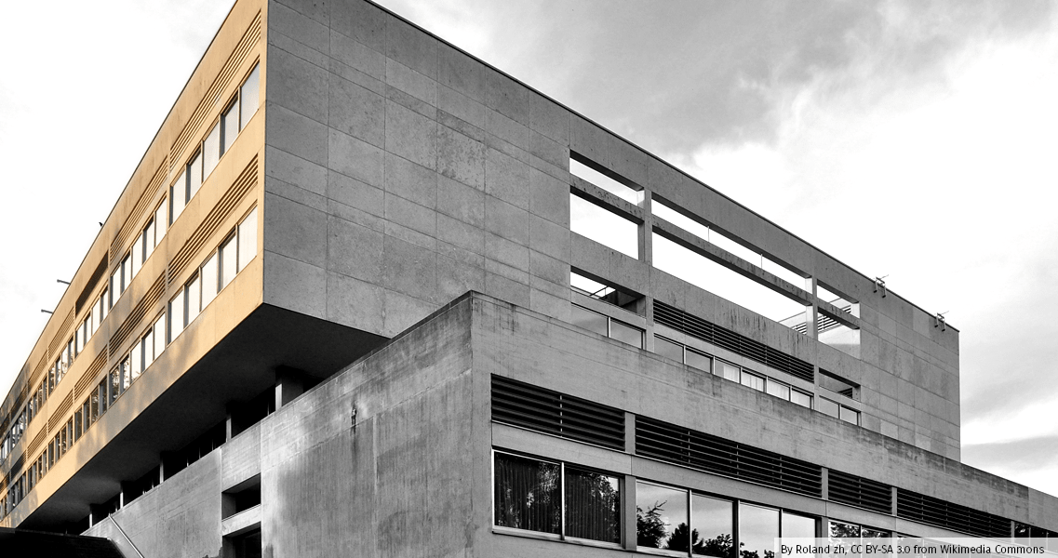
TEACHER’S CALLING
5
CHALLENGE
Creating a system for efficient silent alerts

Slide 14
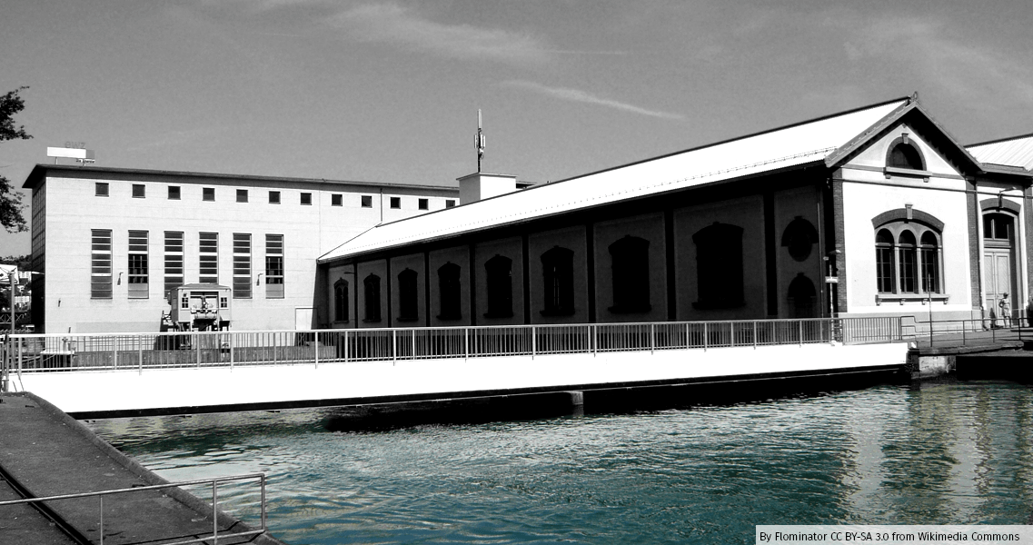
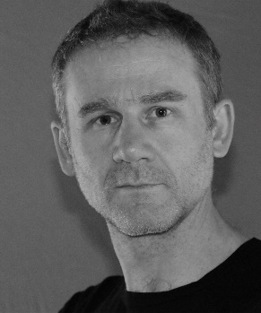
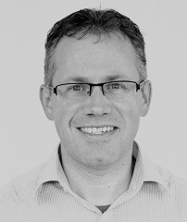
Distribution Grid Power Failure
6
CHALLENGE
How can we improve the detection of power failures in the low voltage network for a more efficient city?
Provided by ewz
Marcus Cathomen
Ferni Donzé
Innovation Project Manager
Corporate and Business Development
marcus.cathomen@ewz.ch
+41 76 232 82 82
Project Planning Manager
Distribution Grid
fernand.donze@ewz.ch
+41 79 412 30 65

Slide 15
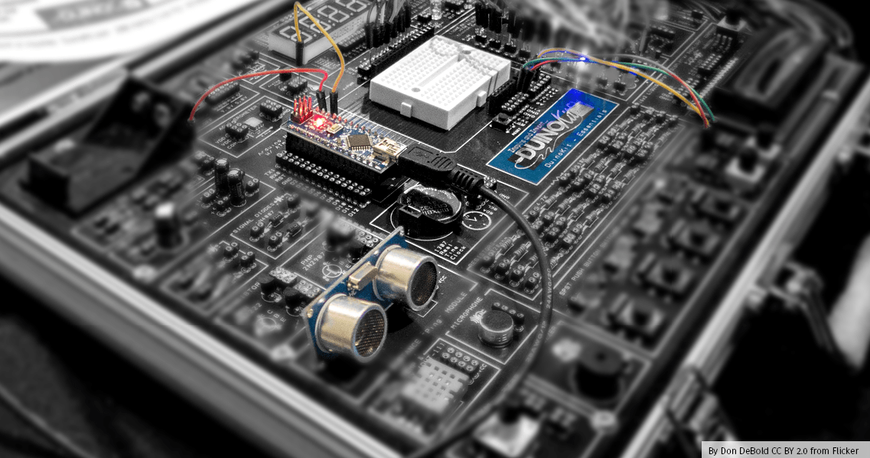
Open Challenge
7
CHALLENGE
If none of the challenges fits you, you are free to combine all available elements and develop your own challenge and ideas!
Provided by you!
Gonzalo Casas
The Things Network Zürich
gonzalocasas@gmail.com

Slide 16
Getting started

Slide 17
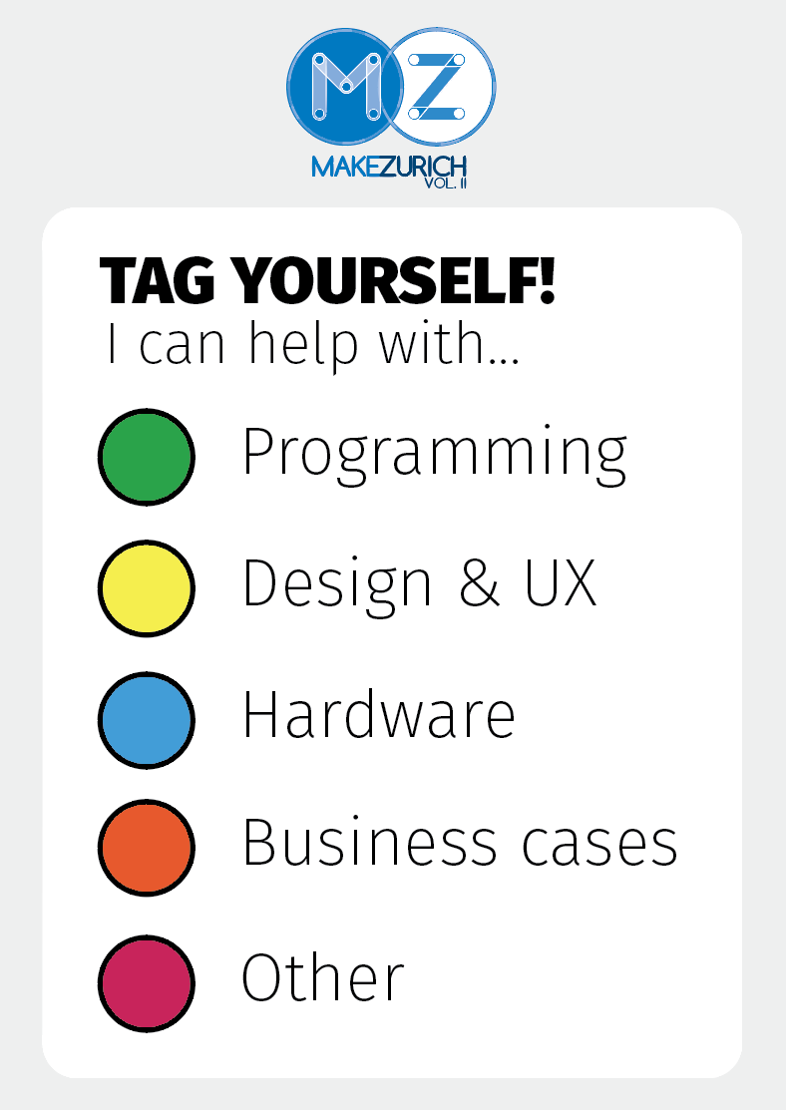
Team up
Tag yourself!
Teams of 2 to 8 people
We can use all the rooms

Slide 18
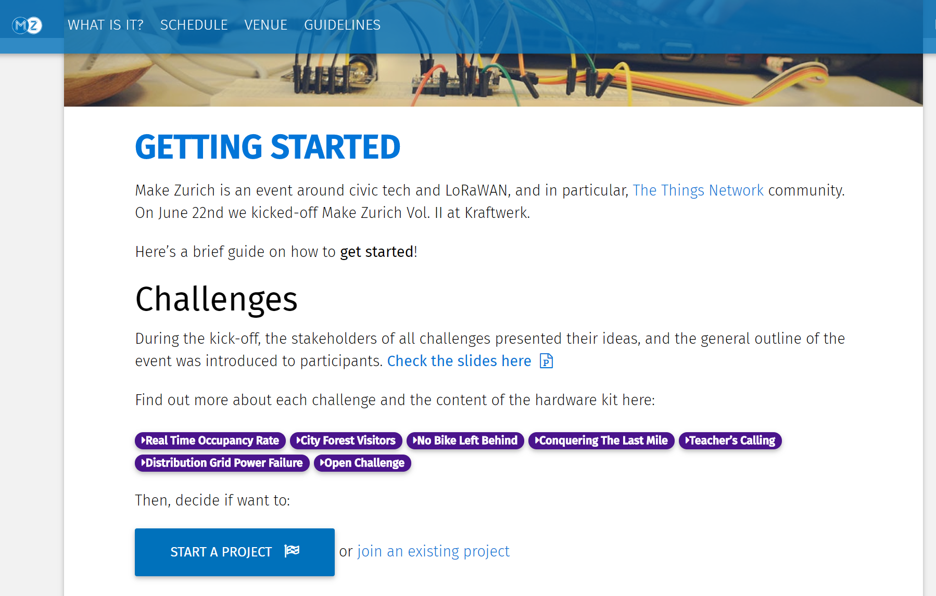
makezurich.ch/start/

Slide 19
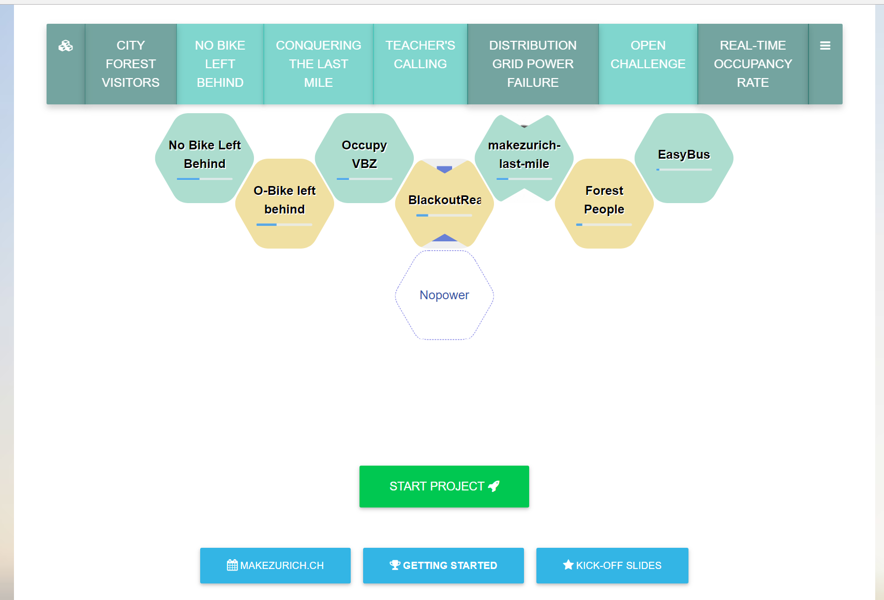
Now.makezurich.ch

Slide 20

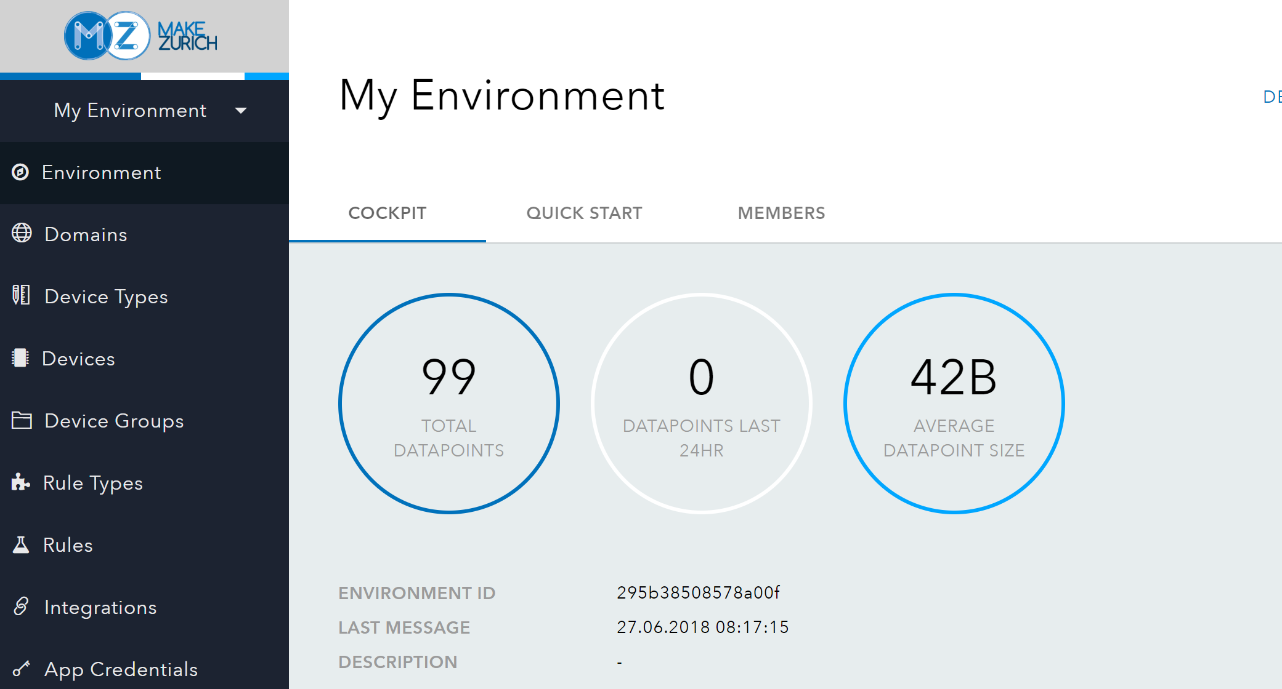
platform.makezurich.ch

Slide 21
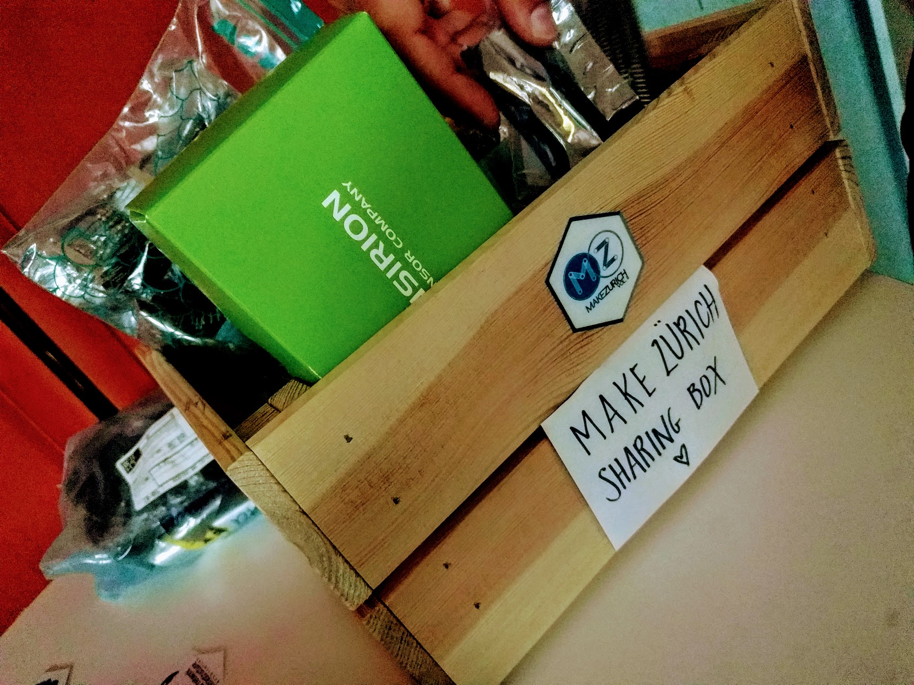
Sharing is caring

Slide 22
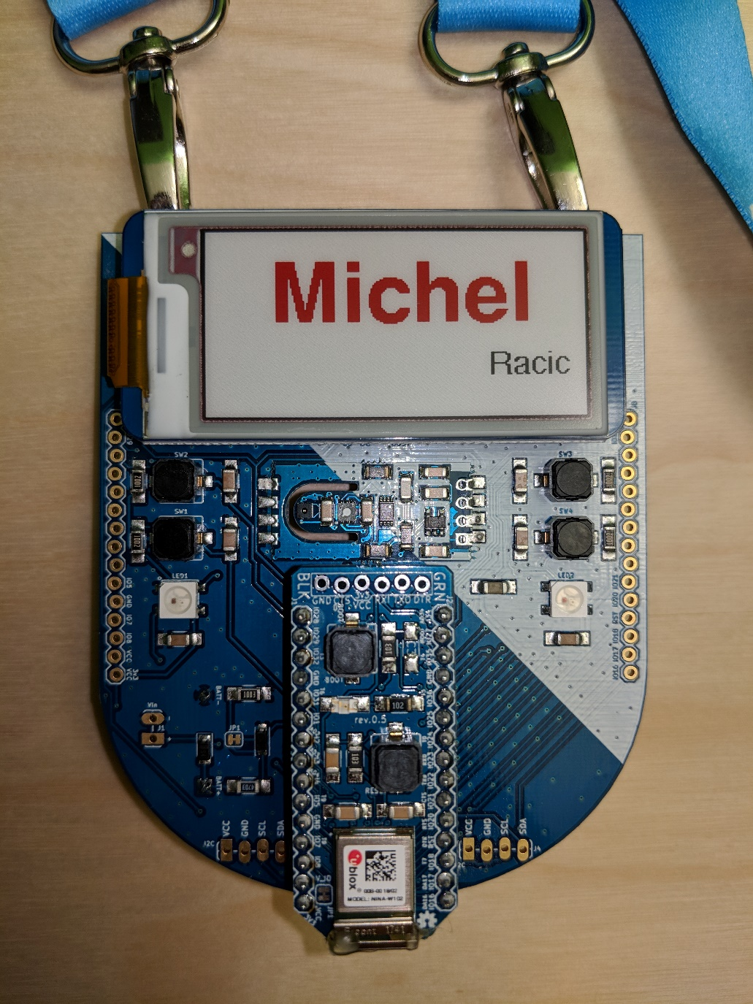
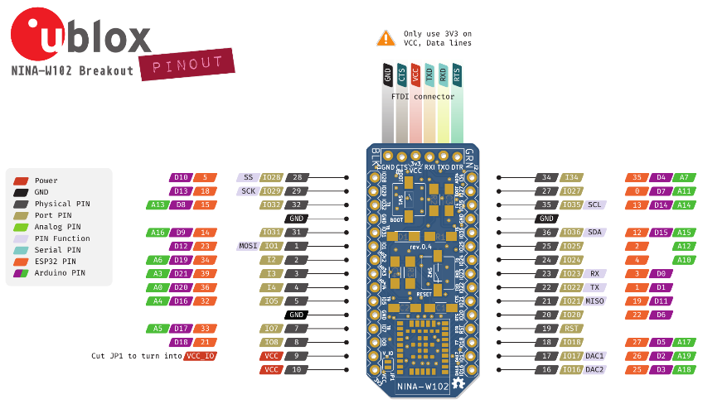
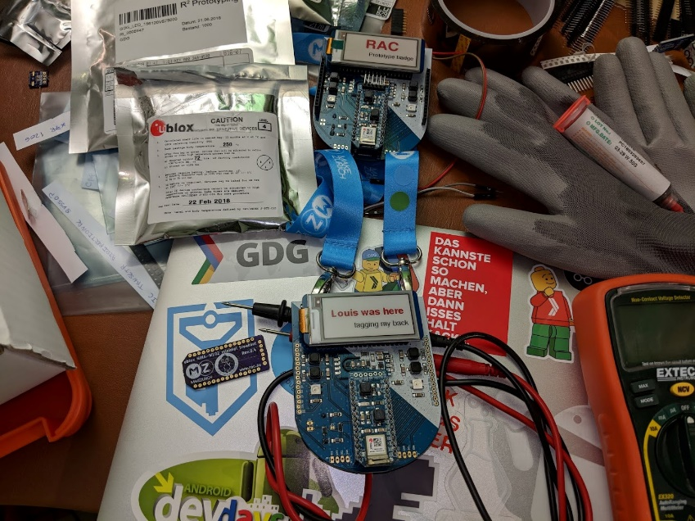
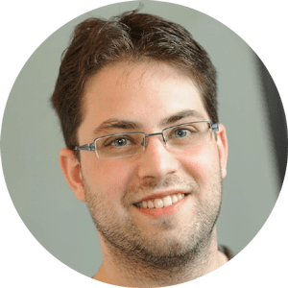
Badge

Slide 23
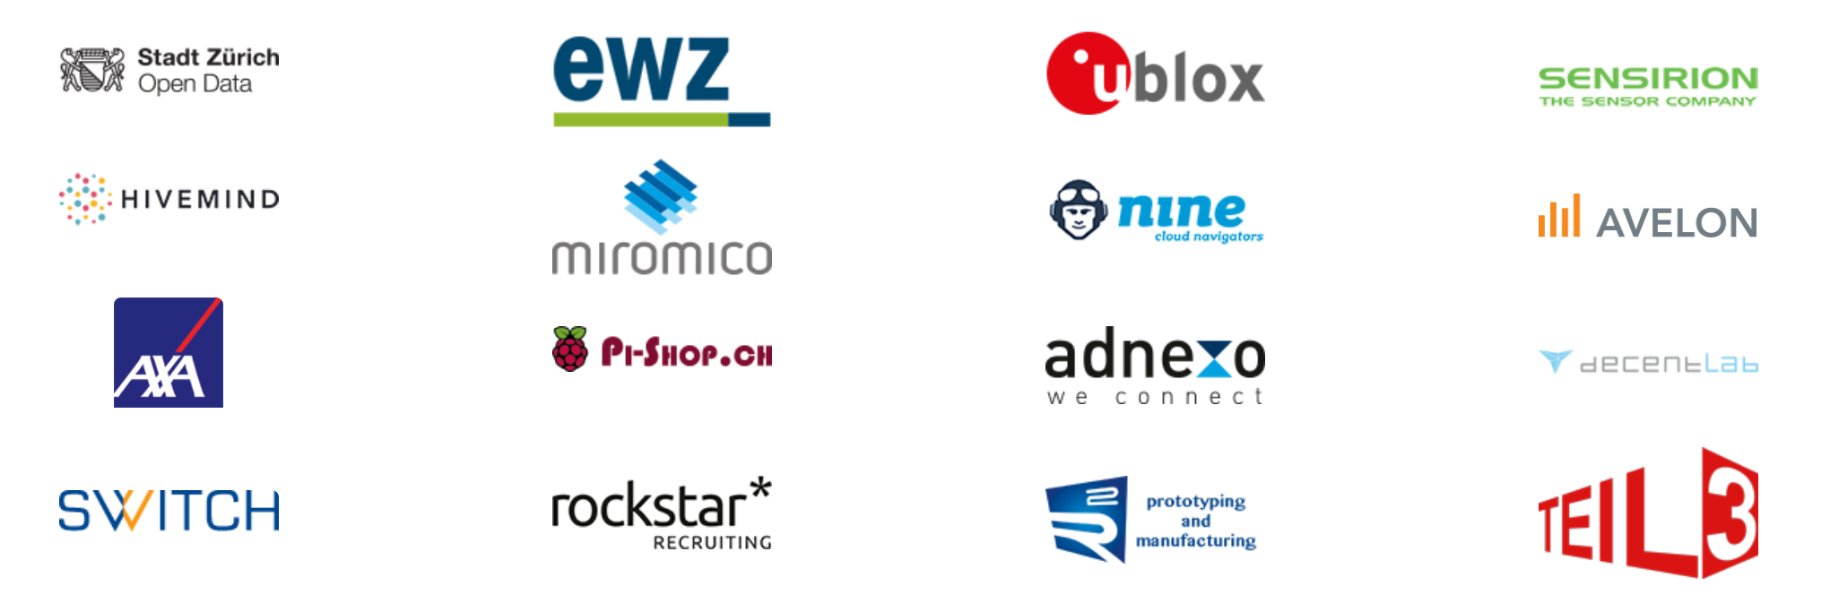
Sponsors and partners

Slide 24

Community partners

Slide 25
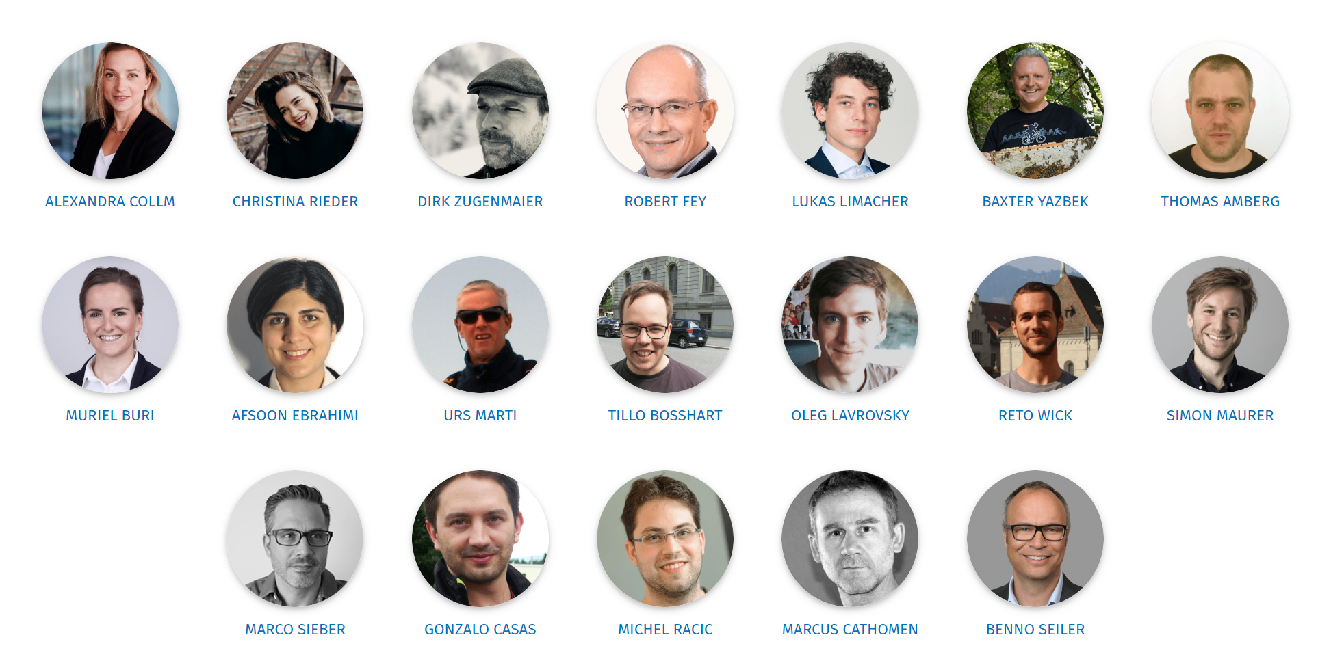
Make Zurich TEAM

Slide 26

Let’s do this!

Slide 27
Civic Tech and LoRaWAN Hackathon for a better city

